Slide 1
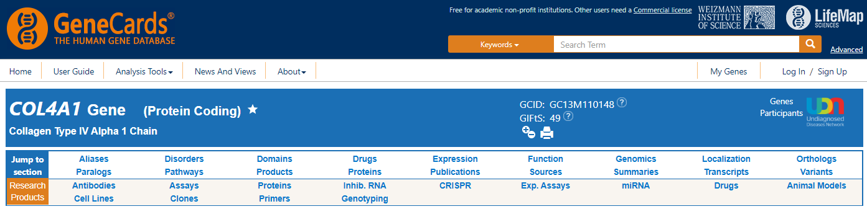

Slide 2
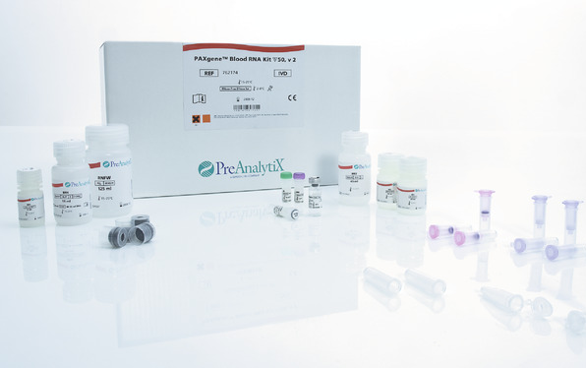

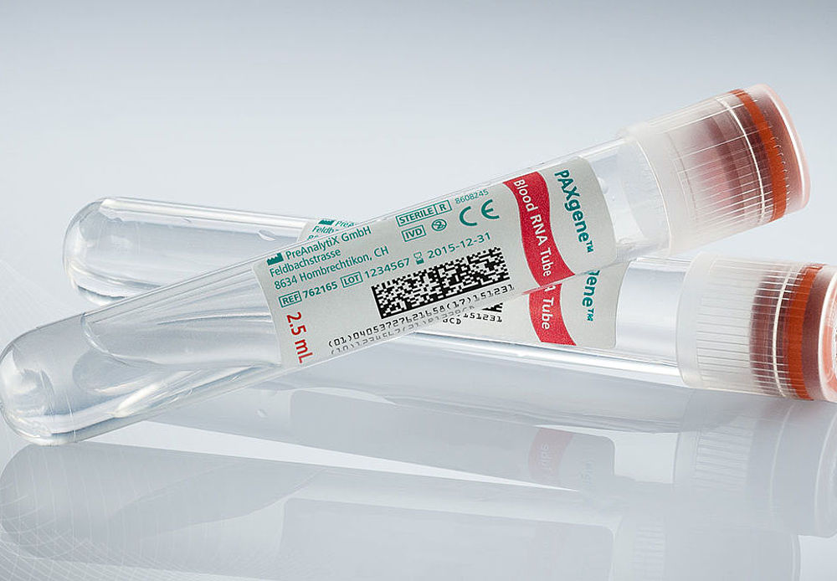
Sample Collection & Processing
Venous whole blood was collected in PAXGene RNA tubes (BD BioSciences)
Contains a buffer that preserves RNAs
Total RNA was then extracted using a precipitation and centrifugation protocol via PAXgene Blood RNA kit (Qiagen)
Samples were then sent checked for RIN quality, library prepped, and then sequenced by the UCSD IGM Genomics center

Slide 3
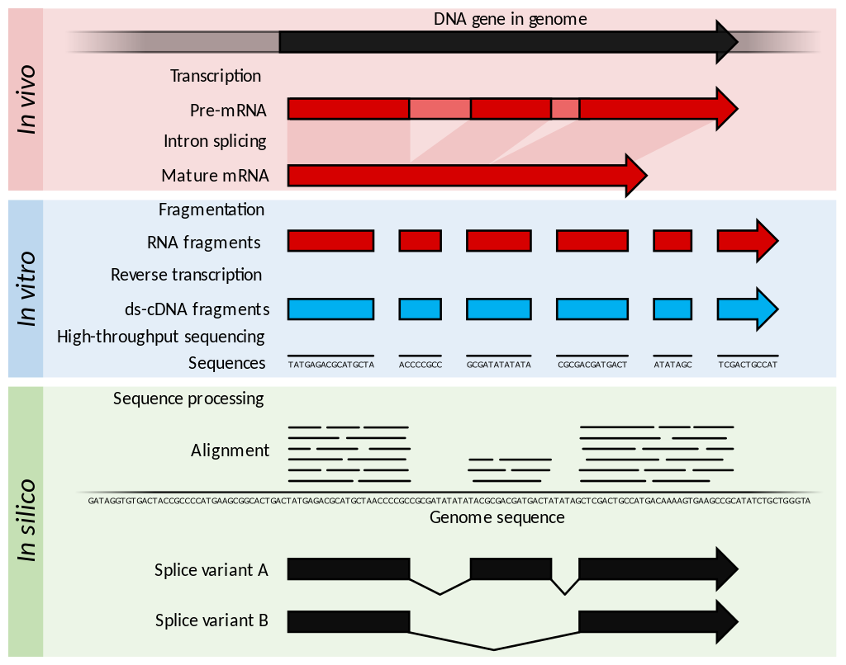
RNA Sequencing Pipeline
Sequence library data analyzed and compiled by the UCSD Center for Computational Biology & Bioinformatics (CCBB)
Checked for sequence-genome alignment, sequencing depth, and variability of samples

Slide 4
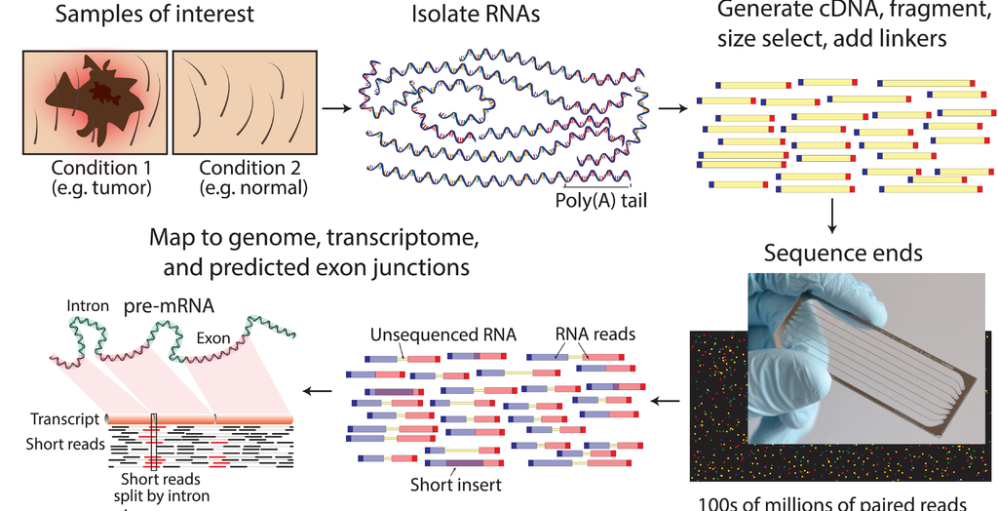

Slide 5

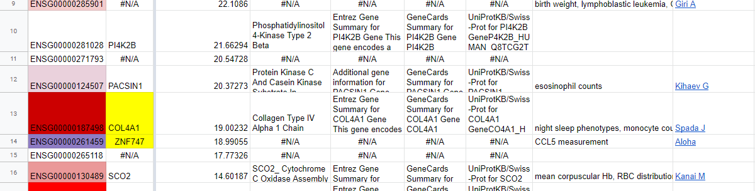
Biological Analysis of Significant Genes

Slide 6
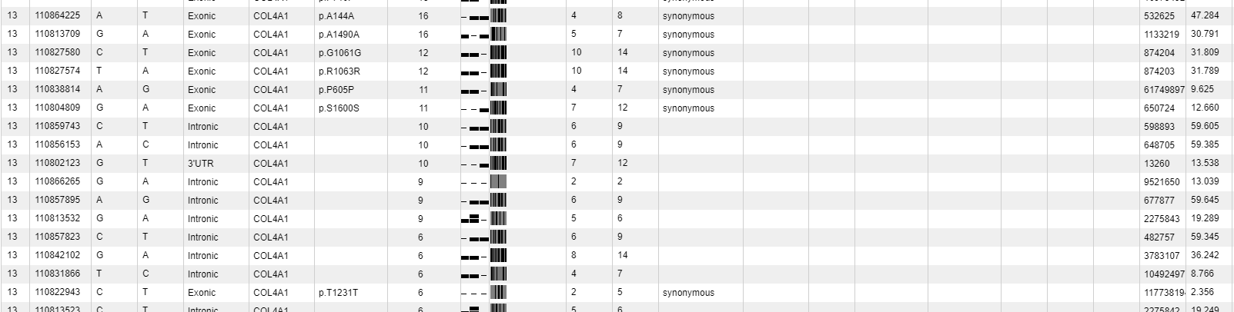
Identification of Potential Functional Variants

Slide 7
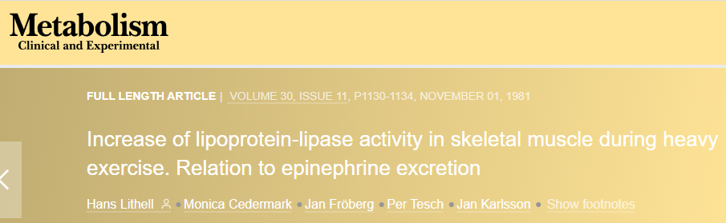
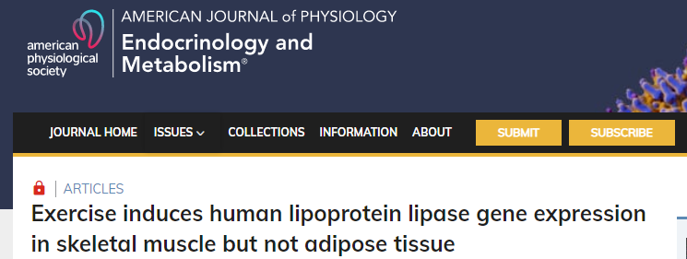
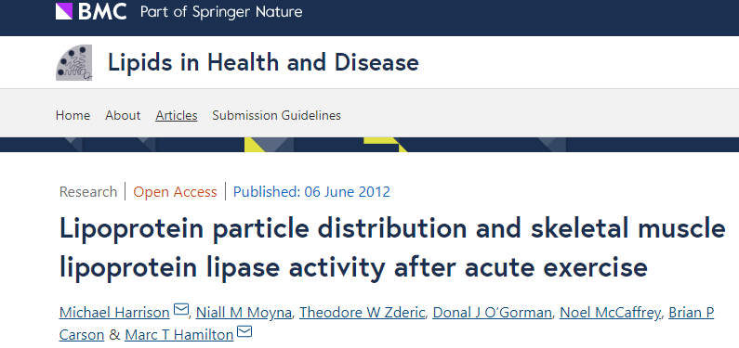
Exercise induced LPL expression in skeletal muscle
ANGPTL4 is transcriptionally regulated by both HIFs and PPARs (Paglina et al., 2017)
N-terminal domain of angiopoietin-like protein 4 (ANGPTL4) inhibits LPL activity
Acts as a reversible, noncompetitive inhibitor (Lafferty et al., 2013)

Slide 8
Citation
La Paglia, Laura et al. “Potential Role of ANGPTL4 in the Cross Talk between Metabolism and Cancer through PPAR Signaling Pathway.” PPAR research vol. 2017 (2017): 8187235. doi:10.1155/2017/8187235
Lafferty MJ, Bradford KC, Erie DA, Neher SB. Angiopoietin-like protein 4 inhibition of lipoprotein lipase: evidence for reversible complex formation. Journal of Biological Chemistry. 2013;288:28524–28534. doi: 10.1074/jbc.M113.497602.

